Slide 1
Revolution in urban mobility & the travel industry
Brett Muney, Zipcar
Carlos Pujol, P3 Global Management Inc.
1
Notes:
1

Slide 2
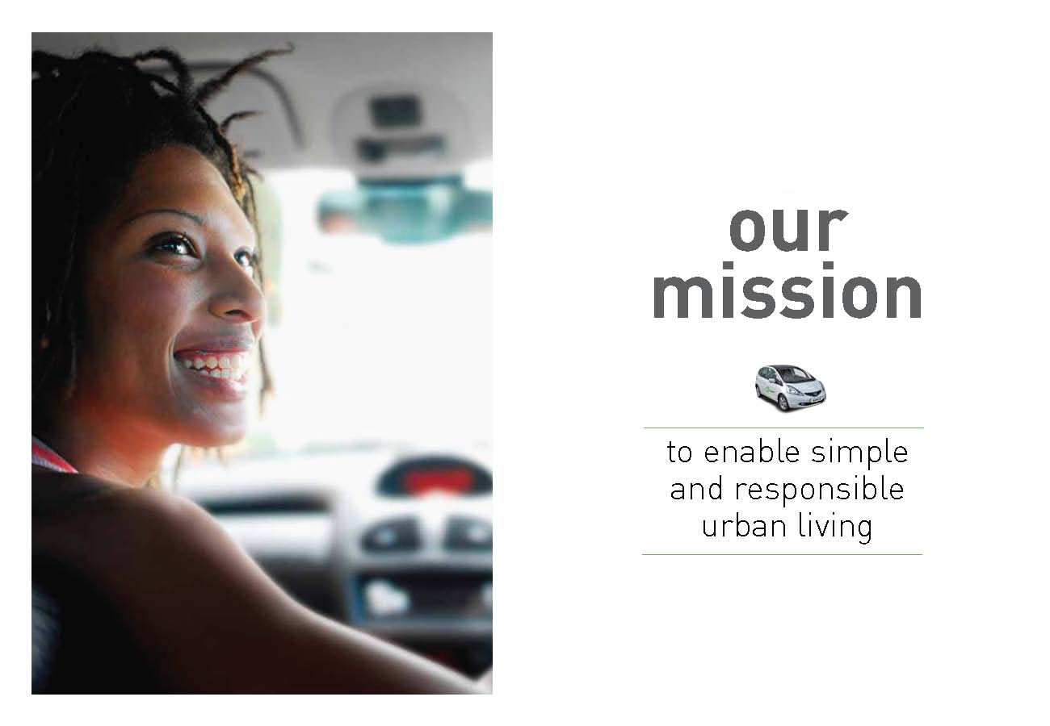
Notes:
Let me quickly tell you a little bit about Zipcar - our mission has been consistent since our founding 15 years ago – to make cities better places to live by enabling simple and responsible urban living
We believe that, by addressing transportation and congestion challenges, we can make cities even greater places to live.
2

Slide 3

Our heritage – SOLVING FOR THIS ….
Notes:
This focus on cities is a bit of a departure from Zipcar’s early days, which started out with a focus on solving climate change
We quickly learned that we had an even bigger, and more immediate problem…
3

Slide 4
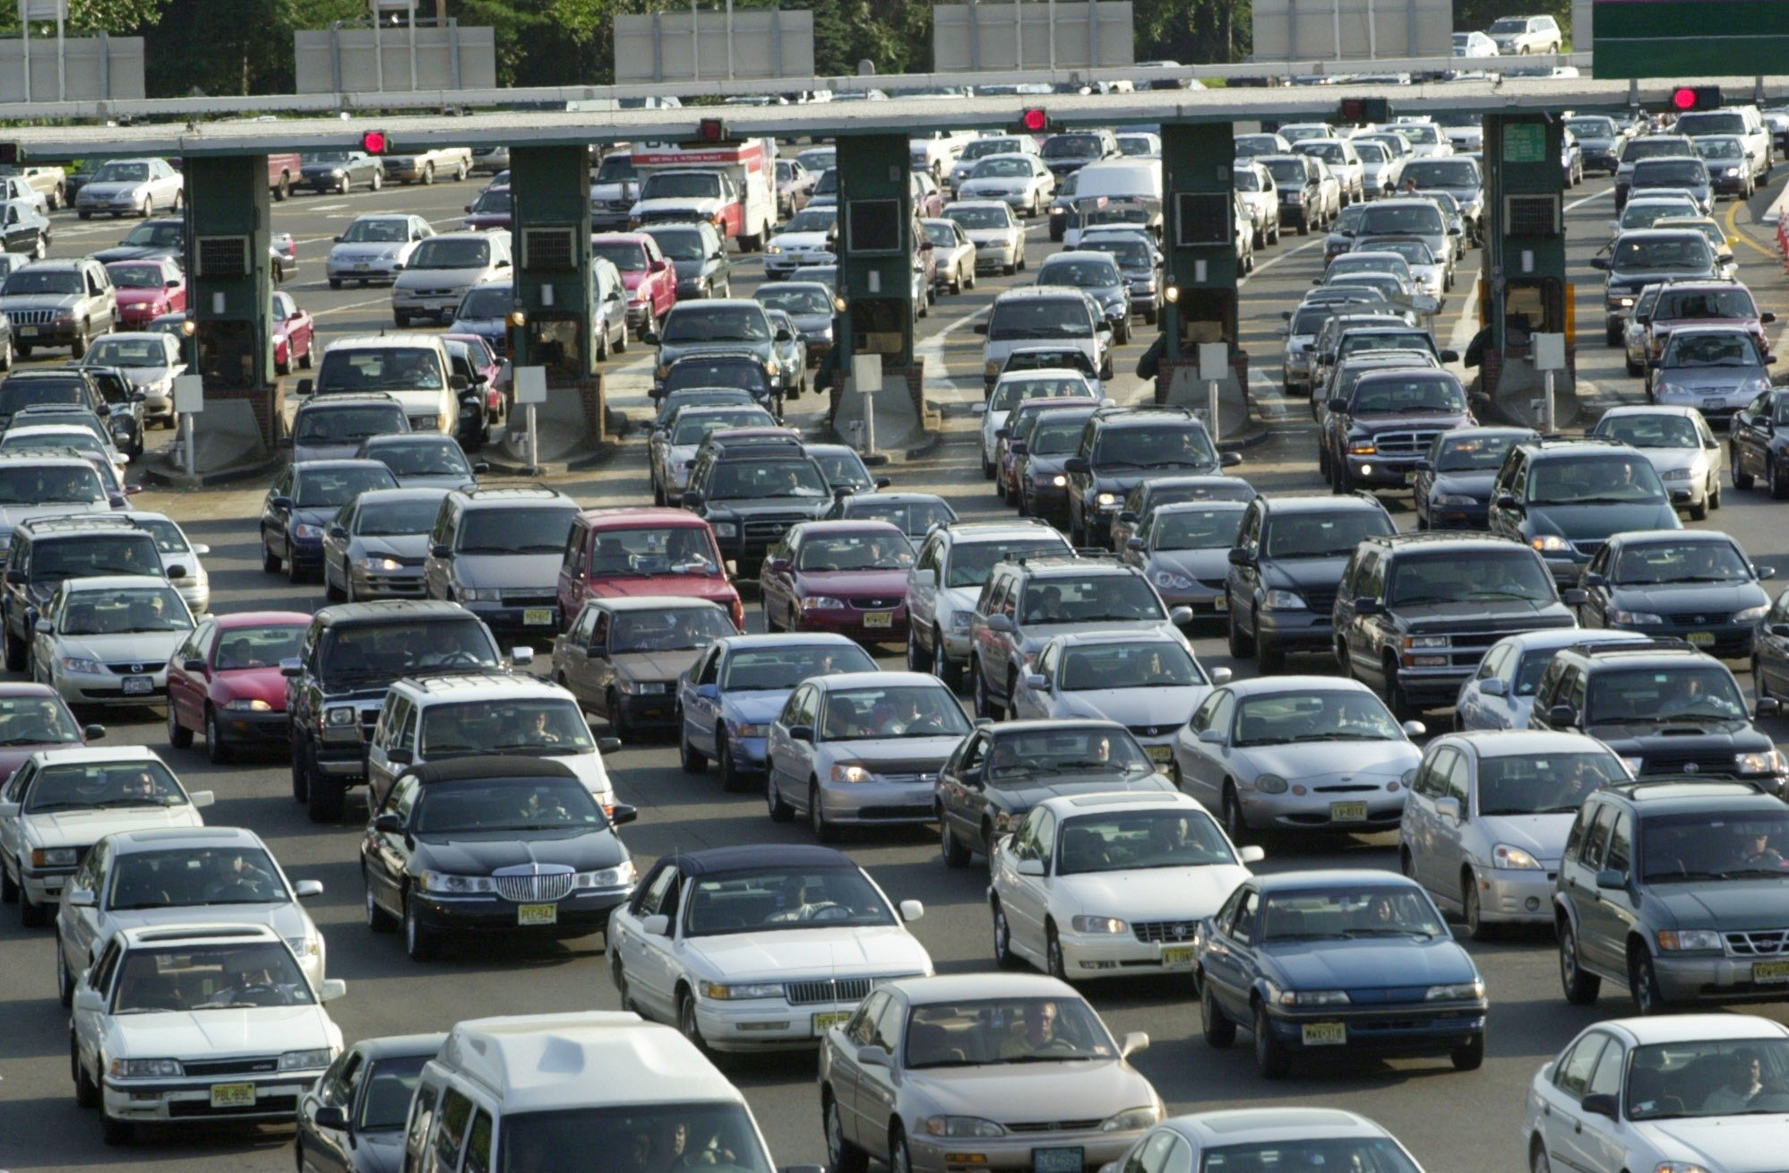
GAVE WAY TO SOLVING FOR THIS …
Notes:
Solving this.
The traditional 1 to 1 relationship between car ownership and a single car has created massive problems for the movement of goods and people in cities around the world.
And it’s only going to get worse.
You think it’s hard to find a parking spot in a city today? Try doing so in 2050 as another 2.5 billion people live in this world.
So Zipcar set out to find a way to make getting in, out and around a city more efficient.
4

Slide 5

ZIPCAR’S SOLUTION
  950,000+ members
  10,000+ cars
  470 cities & towns
  500+ universities
  50+ airports
Notes:
It was a big idea in 2000 when we launched, and I would argue it still is. What if you could give people access to a car when they need one, without them needing to own one?
That’s what Zipcar is – “Wheels when you want them.” We park more than 10,000 vehicles in cities around the world and let our members reserve and drive them by the hour or the day.
Turns out this is a pretty handy solution. More than 50 percent of Zipcar members report selling or avoiding buying a car as a result of Zipcar. And, our own data shows that each Zipcar can meet the needs of between 40 and 50 members.
5

Slide 6
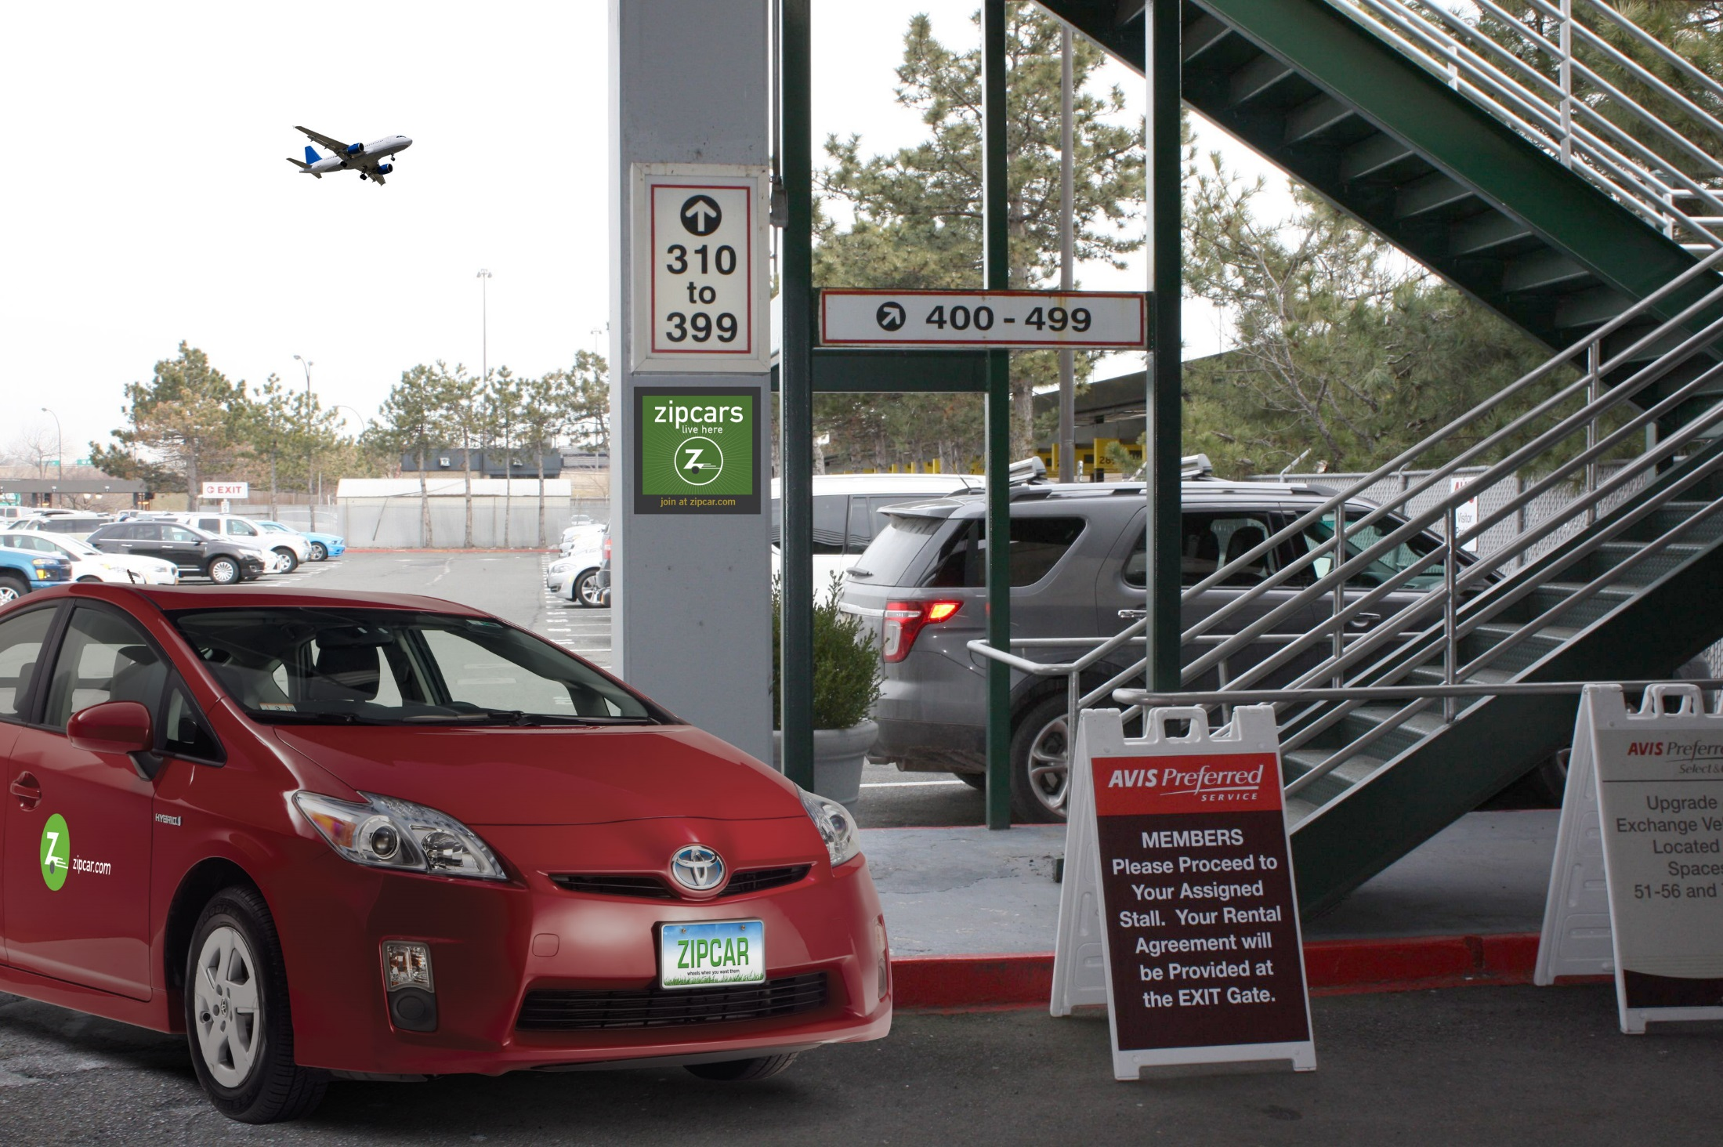
Zipcar For business Travel

Slide 7
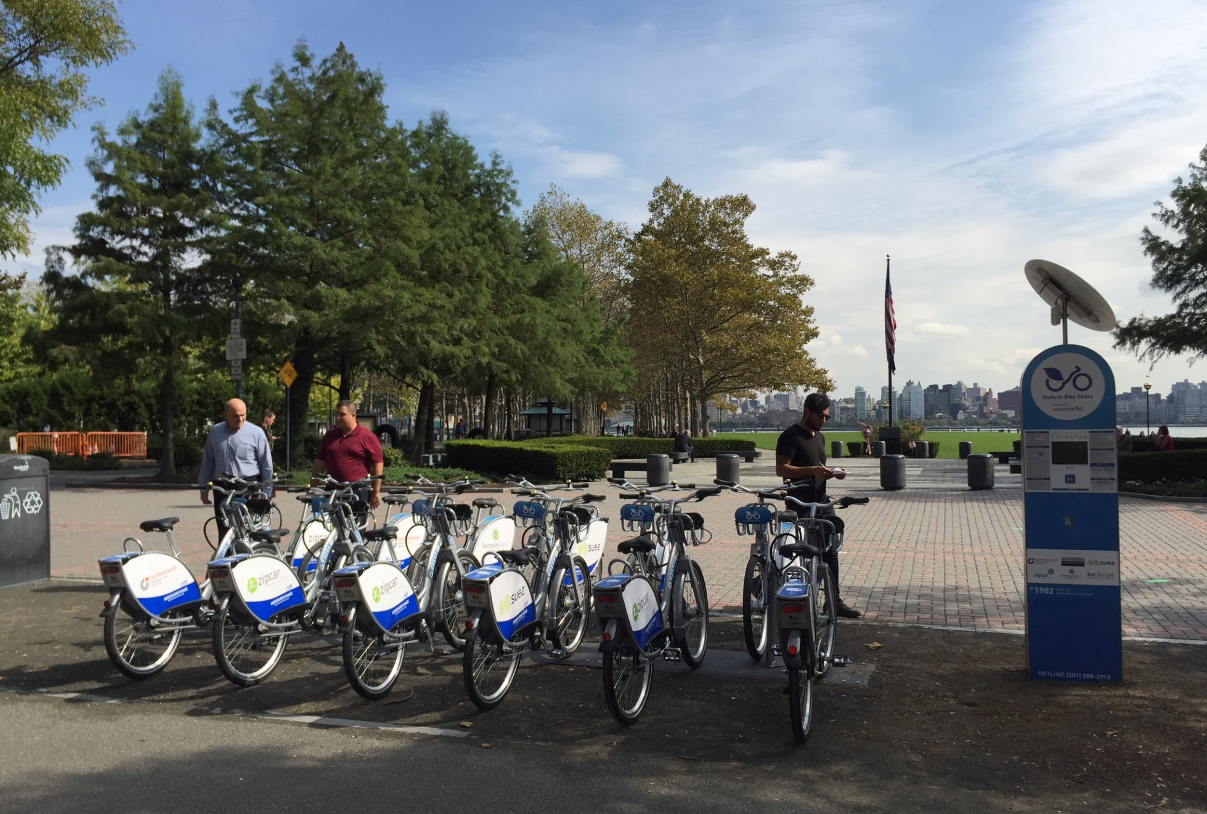

Bike share introduction
Short Distance
Point A to Point B
Urban Transportation
Public Private Partnership
Notes:
Bike sharing is an innovative transportation program, ideal for short distance point-to-point trips providing users the ability to pick up a bicycle at any self-serve bike-station and return it to any other bike station located within the system's service area.
Bike sharing programs are often public private partnership

Slide 8
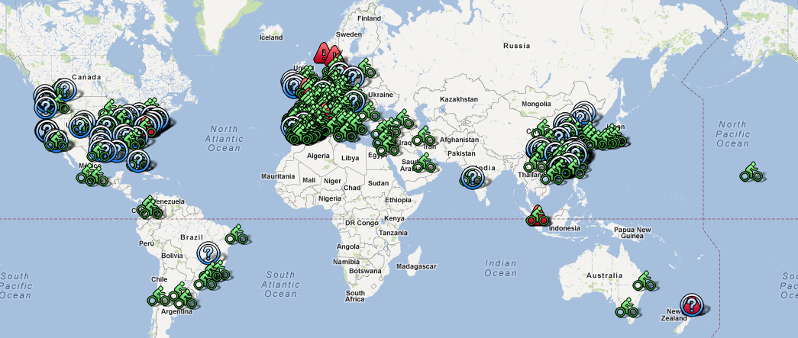
Bike share by the numbers
806,000 bicycles
37,500 stations
712 cities
50 countries
5 continents
Notes:
Bike share is growing rapidly.
Some recently launched bike share programs in the U.S. are Hudson Bike Share and West Palm Beach Skybike.

Slide 9
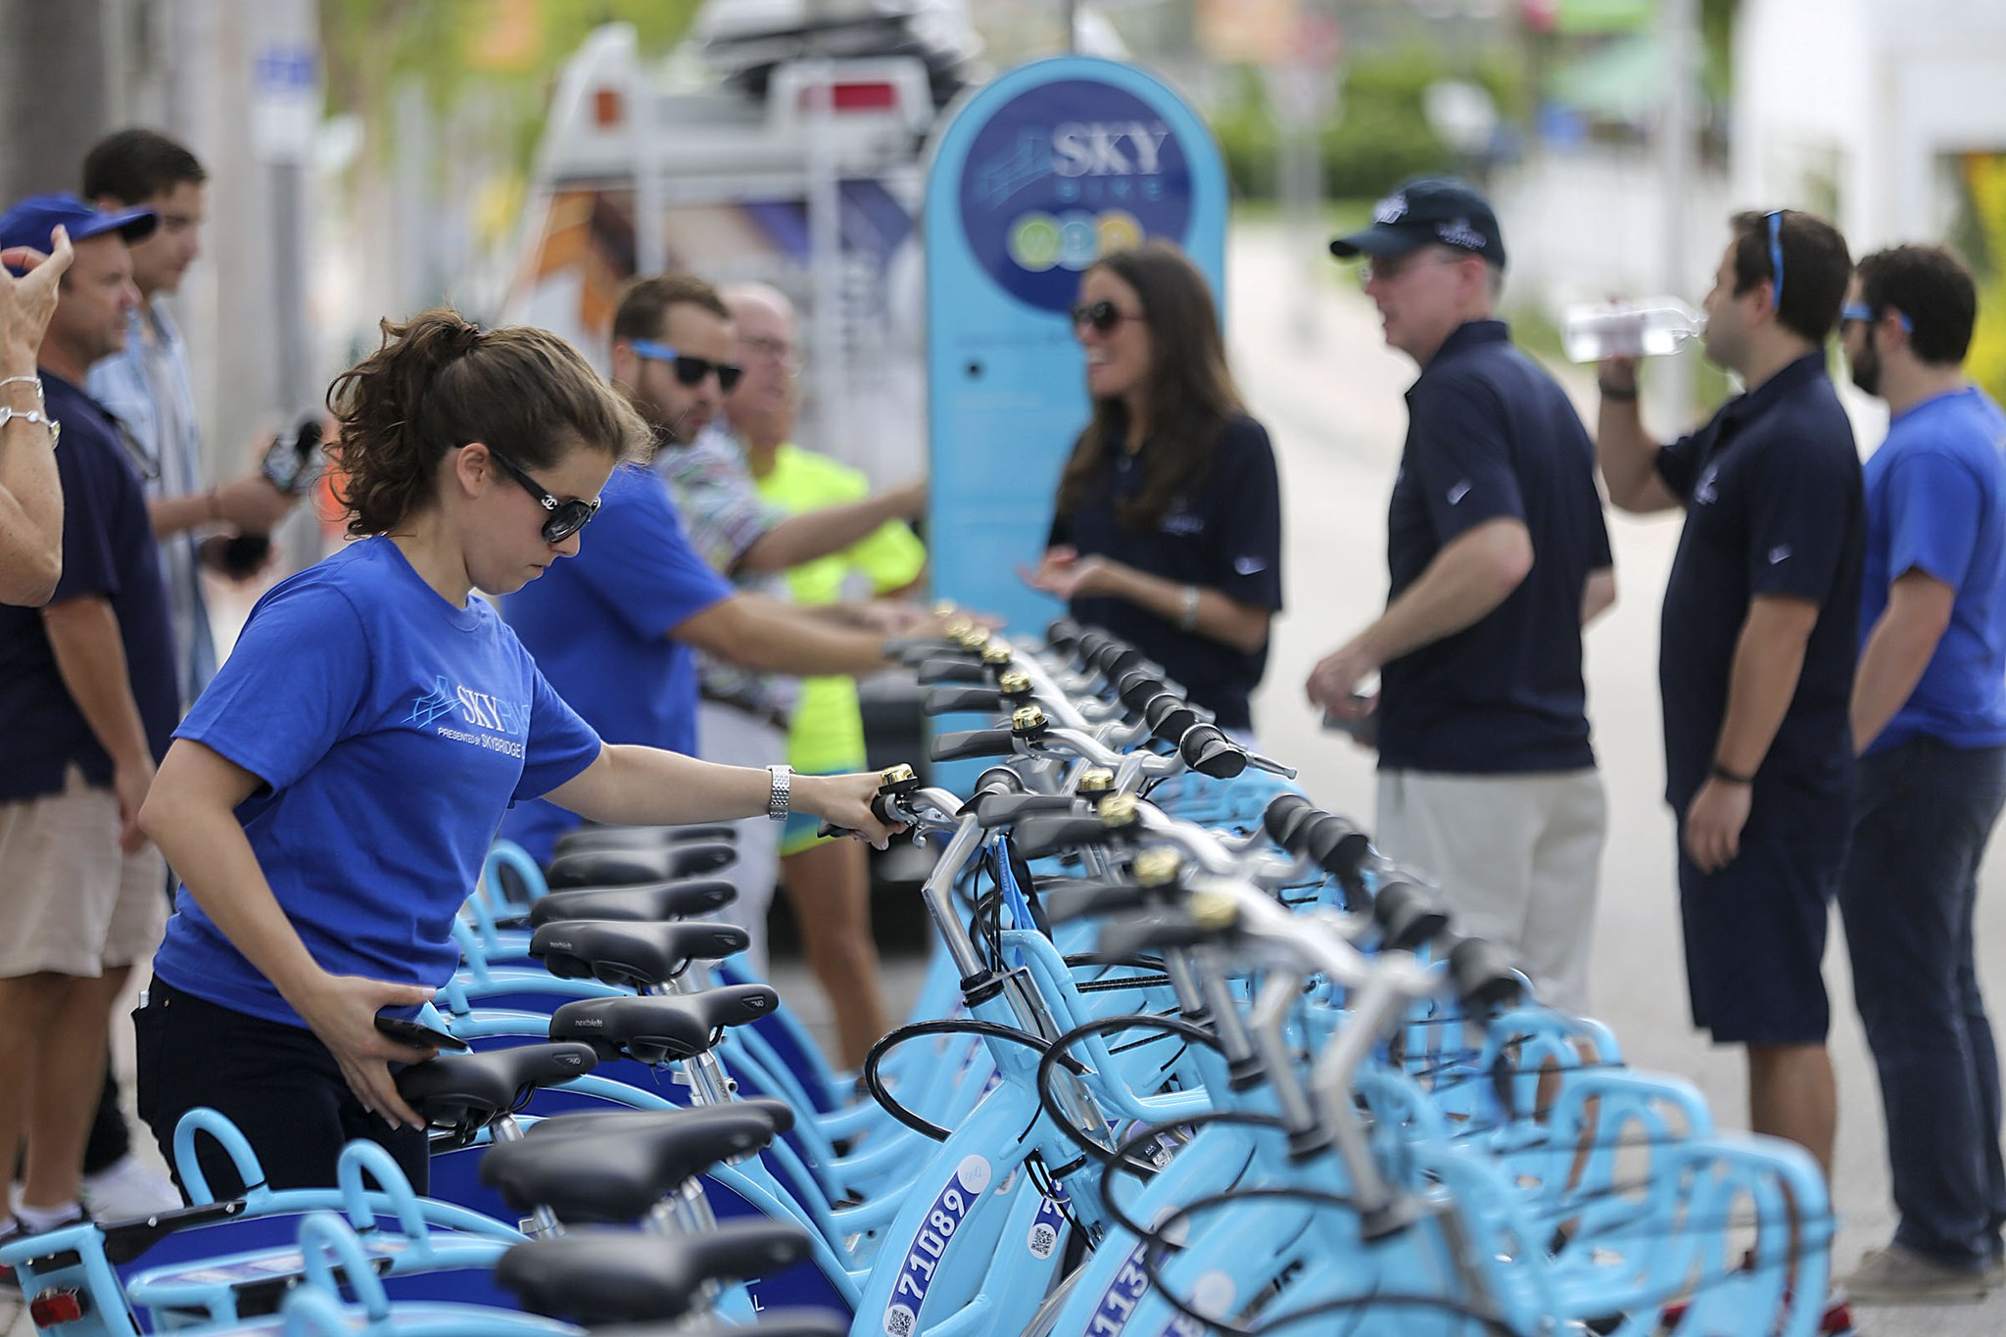
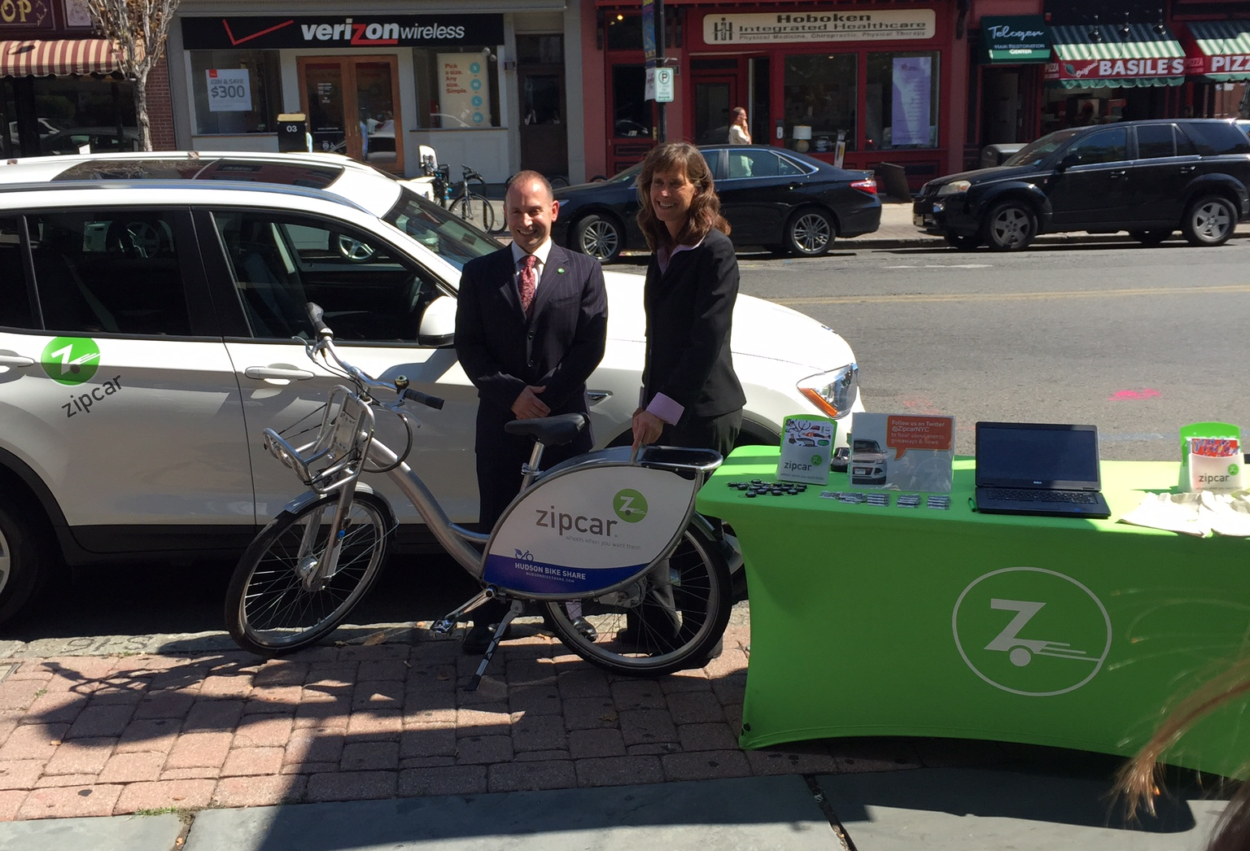
Bike share systems by countries
SPAIN | 132
ITALY | 104
CHINA | 79
GERMANY | 43
FRANCE | 37
SWITZERLAND | 25
UNITED STATES | 22
JAPAN | 9
Notes:
Countries in Europe have spent significant effort in developing a strong bike share system in their cities.
We are still behind many countries in rolling out bike share programs, but they are becoming more and more popular in the U.S.
In the near future most cities of all sizes in the U.S. will have a bike share program. We are working hard to expand this green, innovative urban transportation method in the country.

Slide 10
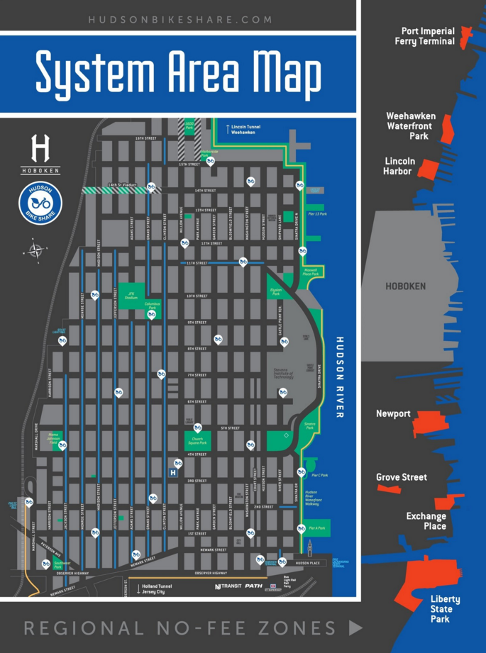



Hudson bike share and benefits
Social Last mile transportation method Reduce traffic Promote healthy lifestyle
Environmental Reduce pollution Improve air quality
Economic Low capital investment New revenue streams
Notes:
Bike share expanding to all cities and countries because of its proven benefits including Social, Environmental and Economic.
Talk about Hudson Bike Share – 250 bikes in Hoboken

Slide 11
Cars gives way to tech
?
Net agree – In your daily routine, losing which piece of technology would have the greatest negative impact on you?
Notes:
11

Slide 12

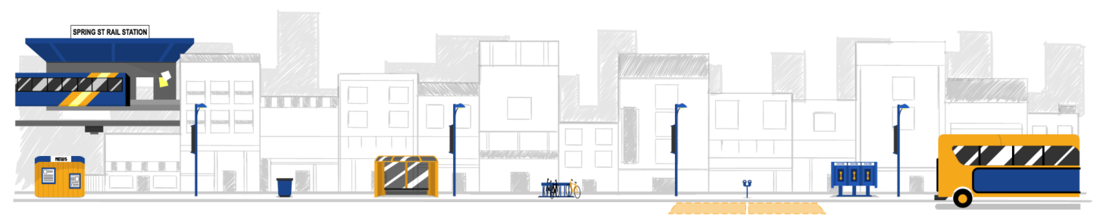




Convergence is here
12
Distance | Most Effective Transportation Method (low cost, less pollution)
More than 100 miles | Airplanes
3 – 100 miles | Car share
Less than 3 miles | Bike share
Notes:
Business Travelers
Take a flight to the city
Bikes (for short distance) and Zipcar (for long distance) are the fastest and most convenient way to get around
Opportunities for partnership between airlines, car sharing, and bike sharing companies.
12

Slide 13
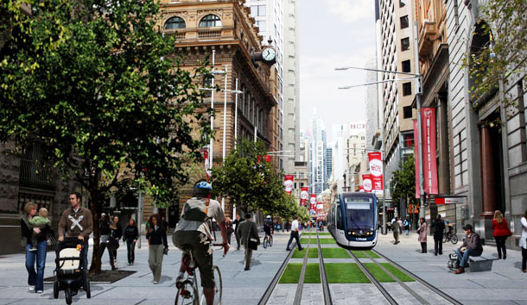
Business travelers a lot like urbanites
Notes:
13

Slide 14
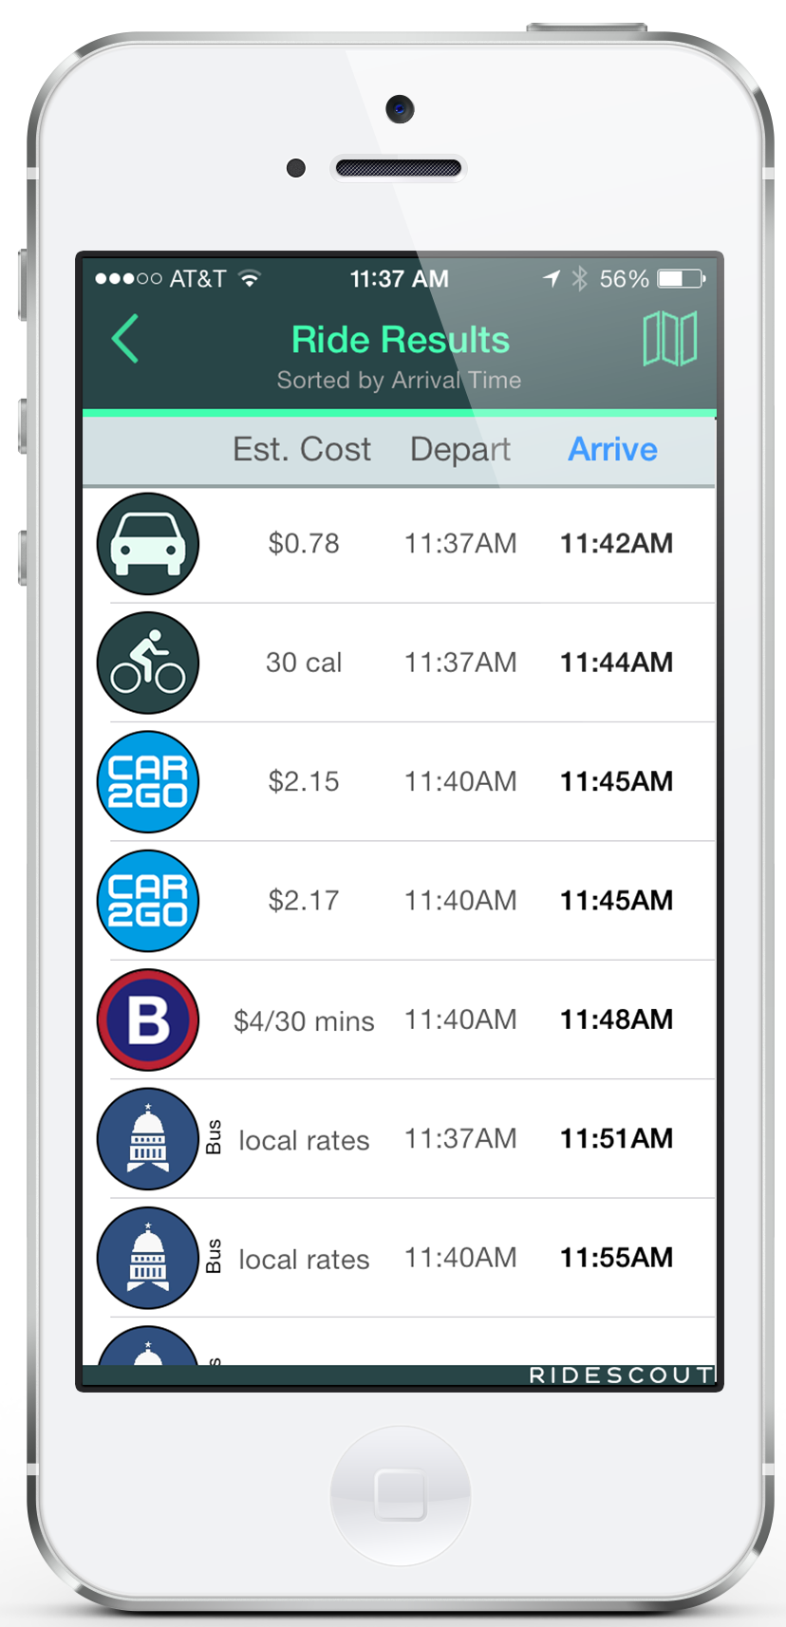
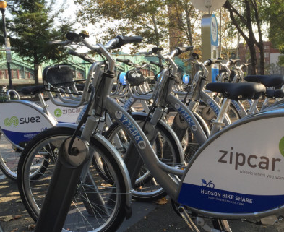
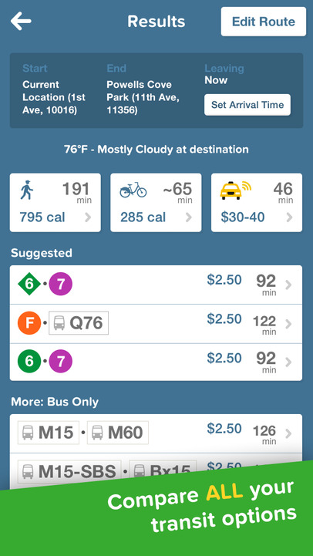
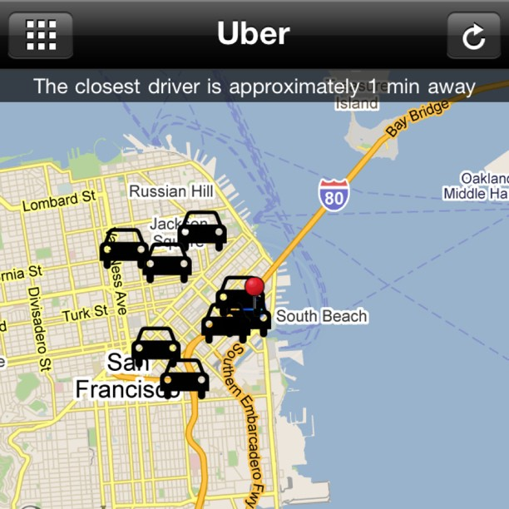
A New Type of Business Travel Package
14
Notes:
14

Slide 15

Questions?
bmuney@zipcar.com

