Slide 1


IATA NDC: The Good,
the Bad, & the Interesting
Presentation to the New Jersey Business Travel Association
Chris Engle
Vice President, Americas Air Commerce

Slide 2








Agenda
What is NDC & Why Does it Matter?
Travelport’s take on it
An example brought to life with Air Canada Summary

Slide 3





WHAT IS NDC?
NDC is a travel industry supported effort launched by IATA for the development and market adoption of a new, XML-based data communication standard (often referred to as “schemas”)
NDC will enhance the capabilities of communications between airlines , intermediaries, and consumers including corporate buyers of travel
NDC is open to any third party, intermediary, IT provider or non-IATA member
Corporate Travel Programs will benefit from NDC
REALLY?
3

Slide 4
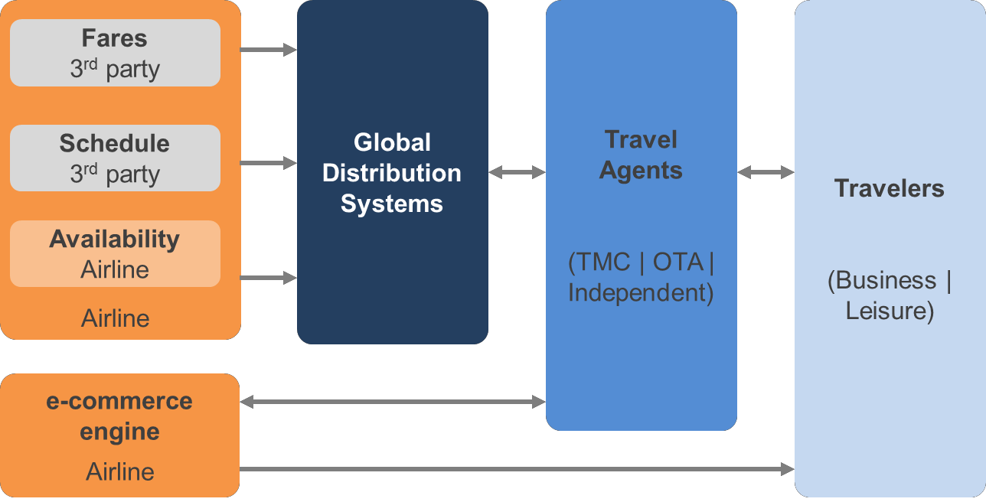
HOW AIRLINES ARE SELLING TO THE OUTSIDE WORLD
Revenue Management pushes fares to
ATPCO
Network Planning pushes schedules to OAG
GDS extract this data and package it together in a generic format for the end user
AC isn’t involved in the transaction at all
AC receives an anonymous sale at the end of the process
This was fine when seats were a commodity and the only
determining factor was price

Slide 5
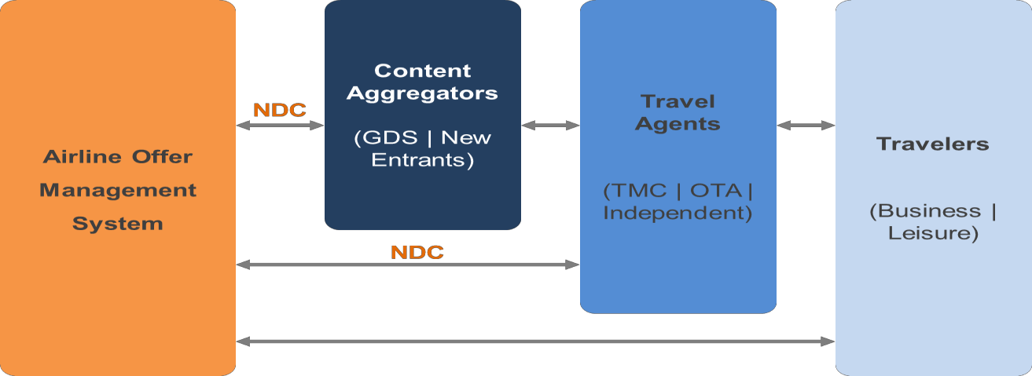
HOW MIGHT AIRLINES SELL MORE INTELLIGENTLY
NDC allows an airline to insert itself in
the economic transaction
At the time of agency search or traveler inquiry, the airline needs to offer dynamic packages based on the customer’s unique desires
Airlines want to monetize perishable products
Airlines would like to leverage relevant ancillary and bundled products for increased revenue

Slide 6
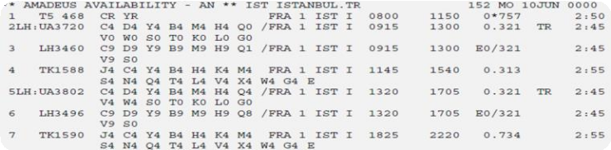
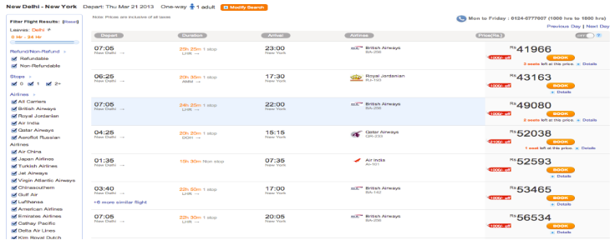
From this……
Travel agents have access to limited and commoditized airline information

Slide 7
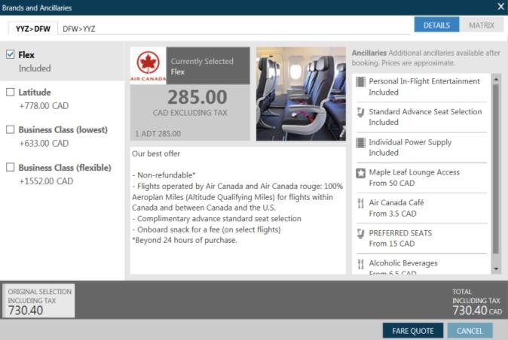
… to this!
Travel agents have access to the entirety of an airline’s product
offering

Slide 8

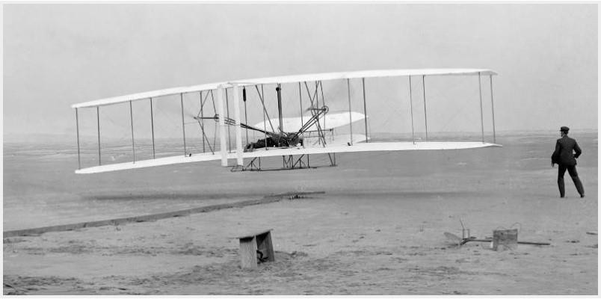
WHY IS THIS SO IMPORTANT TO AIRLINES? (COMPLIMENTS OF AC)
"If I was at Kitty Hawk in 1903 when Orville Wright took off, and would have been farsighted enough, and public-spirited enough -- I owed it to future capitalists -- to shoot them down…”
Warren Buffet
8

Slide 9













SO, SERIOUSLY, HOW COULD CORPORATIONS BENEFIT FROM NDC?
Let’s talk about your “Prime Objectives” (Star Trek)
  Maximizing the value of every dollar your organizations spend on Travel
  Give your travelers the best travel experience possible for the money you spend
  Leverage your organization’s voice for tailored offerings and unique value propositions
  Guard and enhance the duty of care your operations provide your organization
9

Slide 10

Agenda
What is NDC & Why Does it Matter?
Travelport’s take on it
An example brought to life with Air Canada Summary

Slide 11
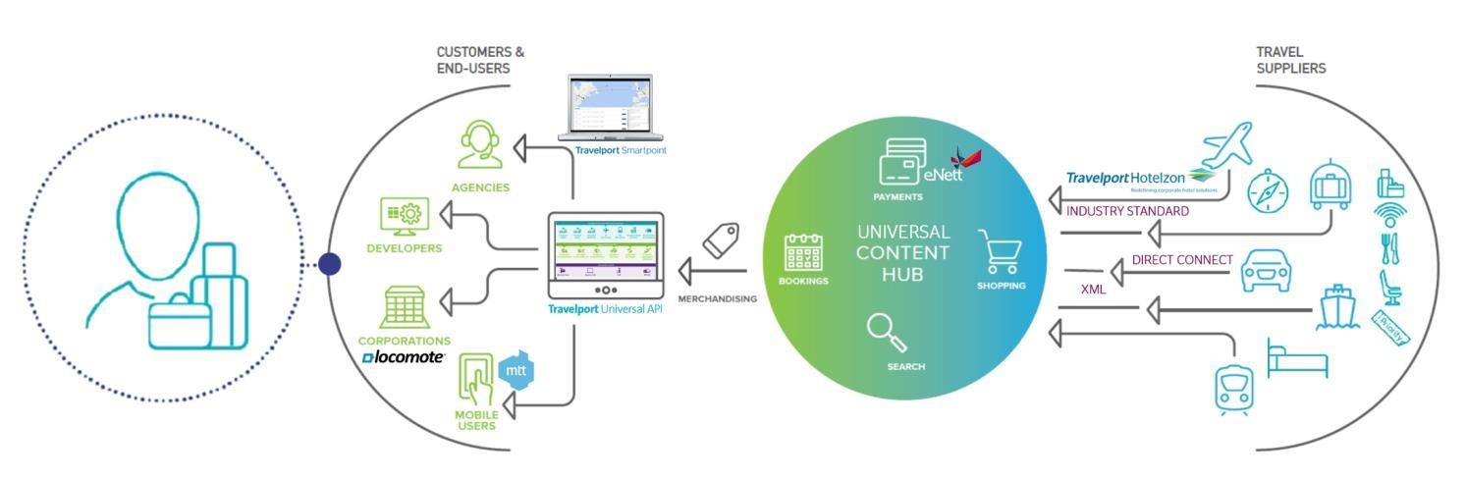
Travelport strategy overview

Slide 12

Travelport strategy – an aside on ancillaries
62%
More traveler satisfaction
and loyalty
23%
Greater competitive advantage
Source: Travelport Business Traveller & Travel Agency Survey 2014

Slide 13


IATA new distribution capability
Fully supportive of airlines’ desire to move to newer, more flexible technology
Engaged with IATA on the NDC Program
Engaged with leading carriers driving the move to XML
Focus is on projects that will result in production bookings at scale as opposed to pilots

Slide 14


Travelport’s view of carrier goals for NDC
Airlines control their own product
Travelport’s Merchandising Suite supports the majority of these goa^{A}l^{i}s^{rl}t^{in}o^{e}d^{s}ay^{se}w^{ll}i^{i}t^{n}ho^{th}u^{e}t ^{c}re^{h}qªu^{n}i^{n}r^{e}in^{l} g^{as}m^{t}a^{h}j^{e}o^{y}r^{s}i^{e}n^{l}d^{l} u^{d}s^{ir}t^{e}ry^{ct}s^{ly}hift
Our point of sale solutions can be regarded as
Communicate the value of products to customers
‘NDC Ready’
Maximize the revenue opportunity

Slide 15
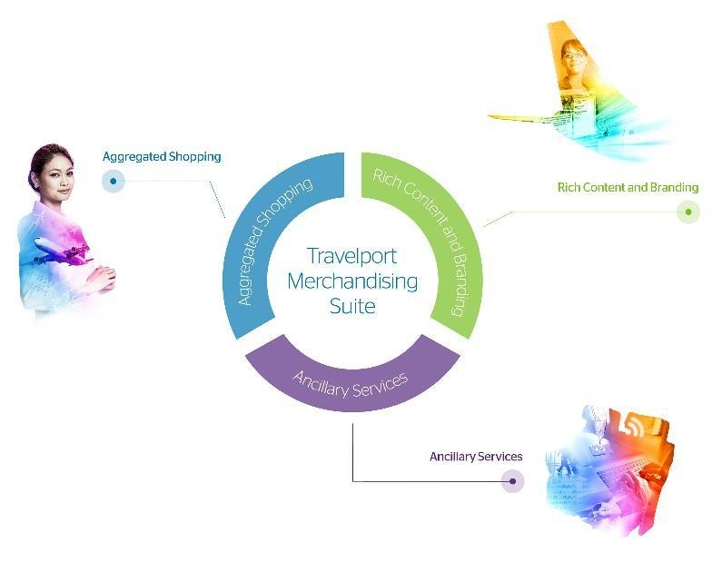
Travelport Merchandising Suite
Enables airlines to sell how they want to sell
Enables agents to book how they want to book

Slide 16
WHO WINS?
Product differentiation
Airline
Marketing the richness and uniqueness of airline products
Marketing personalized offers
Access to full and rich Content
Agent
Compare flight products based on schedule, price AND
value
Work with real-time product and fare data
Transparent shopping
Buyer
Deliver the right products at the right prices
Offer each traveler the opportunity to shop based on what they value – be it anonymous or personalized
16

Slide 17

Agenda
What is NDC & Why Does it Matter?
Travelport’s take on it
An example brought to life with Air Canada Summary

Slide 18
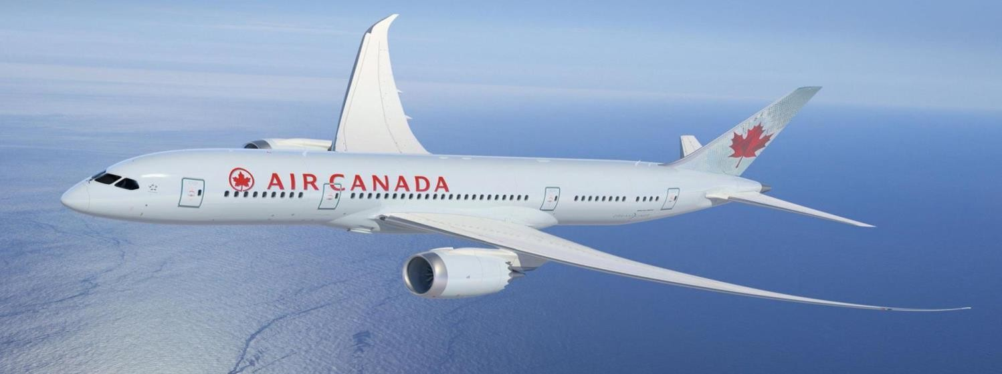
Let’s take a test flight!
– 18

Slide 19

What agents see

Slide 20

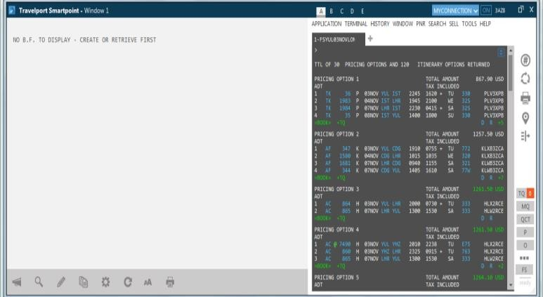
Fare shop results
Montreal to London

Slide 21
Fare shop results
Montreal to London
Fare Price shown in white indicates carrier does not participate in Rich Content and Branding

Slide 22
Fare shop results
Montreal to London
Fare Price shown in white indicates carrier does not participate in Rich Content and Branding
Fare Price shown in green indicates carriers that do participate in Rich Content and Branding
Agent clicks on the fare to access
branded fares and ancillaries

Slide 23
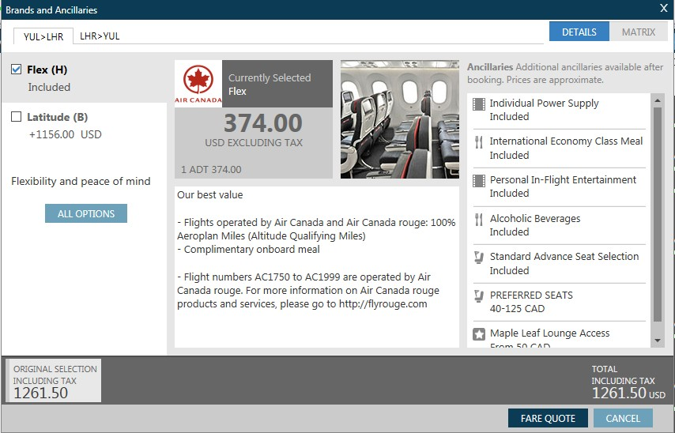
Branded fare name

Slide 24
Airline imagery

Slide 25

Product description/ sales message

Slide 26
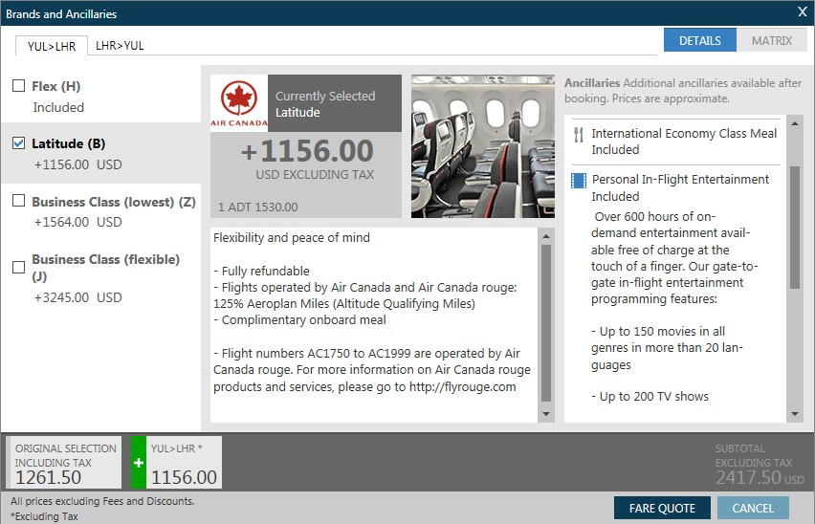
Detailed product description including sales message and rules

Slide 27

Upsell price and message

Slide 28
Link to fare comparison table

Slide 29
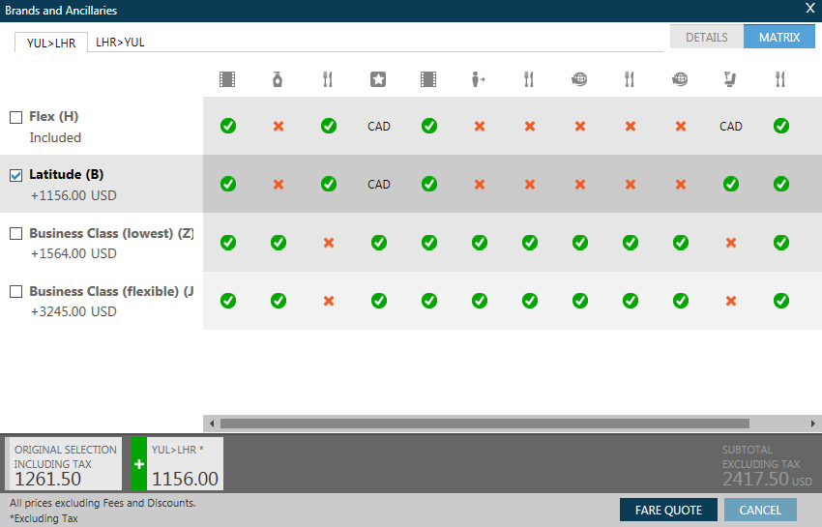
Branded Fares benefit too!
Matrix view of available services and fare differential

Slide 30
Comparison table
X = not included
✓ = included
CAD = chargeable

Slide 31
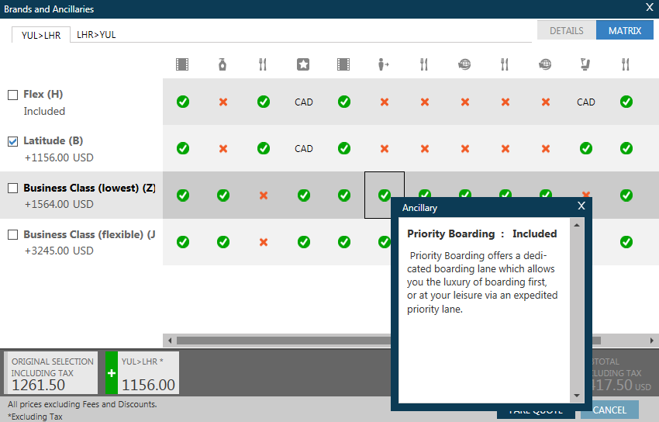
Rich content description and indicative price

Slide 32
Fare differential to higher branded fare

Slide 33


Agenda
Travelport strategy
Air Canada strategy Test flight
Summary

Slide 34



Summary: What are we all working towards?
An efficient retail ecosystem for
Travelers and Travel Buyers
NDC can be a facilitator of that.

Slide 35


